Slide 1
Medication Management in Adult Care Sector Community Services
(Train the Trainer)
This training is intended to be delivered over a minimum of 4 hours. This can be 2x2 hr sessions but the trainer must bear in mind that the quiz at the end covers all the slides.
The trainer must use the notes, where attached, for each slide in their delivery. These are an aid to discuss the background of the slide content.
The trainer will need access to a flip chart or similar for board blasts.
Updated 02/2022

Slide 2
Aims
To understand the administration, record keeping, safe storage & disposal of medication within your role as a Care Worker
To understand your role as a care worker with respect to the Joint East Riding of Yorkshire Council and the NHS East Riding of Yorkshire Clinical Commissioning Group Policy
To be aware of Legislation and Guidance governing medication
Notes:
Run through the aims of the session with emphasis on recent changes

Slide 3
Objectives
Demonstrate the administration of medication with in your role
Demonstrate the use of the Domiciliary Medication Administration Record
Discuss the barriers to taking medication
List key Legislation and Guidance
Discuss the Joint ERYC and NHS ERY CCG Policy
Consider the issue of consent, independence and capacity
Explain what you would do if you had any concerns over medication
Discuss medication errors
Notes:
Run through the Objectives of the session

Slide 4
Legislation, Guidance and Policy
Medicines Act 1968 + amendments
Misuse of Drugs Act 1971
Health and Safety at work 1974
Control of Substances hazardous to Health Regulations 1999(COSHH)
Access to Health records Act 1990
Hazardous Waste regulations 2005
Health and Social Care Act 2008 (Regulated Activities) Regulations 2014
NICE: Managing Medicines for adults receiving social care in the community(NG67)
Care Quality Commission Professional Guidance
Joint ERYC and NHS ERY CCG Policy “Administering Medication Safely in the Home Care Sector” June 2021
Data Protection Act 2018 /UK GDPR (-2021 Update)
Refer to
Pre-Workshop Booklet
Notes:
Show the care workers the Joint ERYC and NHS ERY CCG Policy – Administering Medication Safely in the Domiciliary Care Sector – latest version November 2018.

Slide 5
Health and Social Care Act 2008 (Regulated Activities) Regulations 2014
  Details the fundamental standards which service providers must meet.
  The safe care and treatment standard (regulation 12) includes “The proper and safe management of medicines”
  Other standards are also relevant to medicines, e.g.
      - Person-centred care
      - Need for consent
      - Good governance
      - Duty of candour
Notes:
Discuss the fundamental standards and those associated with medicines:
Regulation 9 - Person centred care – an individual must have care or treatment that is tailored to their needs and preferences.
Regulation 10 - Dignity and Respect – an individual must be treated with dignity and respect at all times whilst receiving care and treatment – this includes promoting privacy, treating people as individuals and giving individuals the support they need to help them remain independent.
Regulation 11 - Need for consent – an individual (or their advocate) must give their consent before any care or treatment is given to them.
Regulation 12 - Safe care and treatment – an individual must not be given unsafe care or treatment or be put at risk of harm that could be avoided – this means that service providers must ensure their staff have the qualifications, competence, skills and experience to keep you safe.
Regulation 13 - Safeguarding service users from abuse and improper treatment – an individual must not suffer any form of abuse or improper treatment whilst receiving Care. This includes: neglect, degrading treatment, unnecessary or disproportionate restraint, inappropriate limits on your freedom.
Regulation 17 - Good governance – service providers must have effective governance and systems to check on the quality and safety of care, which help the service improve and reduce any risks to individuals health, safety and welfare.
Regulation 20 - Duty of candour – the service provider must be open and transparent with individuals about their care and treatment and should something go wrong they must tell the individual what has happened, provide support and apologise.

Slide 6
Roles and Responsibilities
What are the roles and responsibilities of :
  The Service User?
  Community Wellbeing Teams (formerly Care Management)?
  Care Agencies?
  Care workers?
  GP?
  Dispensers?
  Nursing Personnel?
Refer to your pre-workshop booklet for full details
Notes:
Roles and responsibilities
In groups, identify 3 or 4 roles & responsibilities for the following:
The Service user
Community Wellbeing Teams (formerly Care Management)
Care Agencies
Care Workers
GP
Dispensers (Community Pharmacies/Dispensing GPs & some hospitals)
Nursing Personnel
Each group to record their answers
Trainer to ask for feedback from each group and capture the feedback on flip-chart – put slide(s) up for each area as we do this and highlight any areas not mentioned.

Slide 7
Roles and Responsibilities - Service user
The level of responsibility for medication assumed by an individual service user will depend on their ability to manage this aspect of their life.
The Medication Risk Assessment for Domiciliary Care Providers will identify the level of assistance required.
If assistance with medication is required then the service user must provide the Domiciliary Care Agency (DCA) with access to the prescription, medicine and other relevant information and, if they have capacity, consent must be given to assist with medication.
If support is required for ordering repeat medications, and the DCA has been identified as giving that support, then consideration should be given to allow the care agency to order medication on-line from the service user’s GP. This would require the service user to allow third party access to their patient record.
Notes:
The assessment includes the Fullers risk tool in Appendix 1
The Service User must agree to give access to the Domiciliary Care Agency (DCA) to support with medication if they have capacity which may involve being able to order the medication on their behalf as well as administer.
Some surgeries will give the DCA online access as a third party if the Service User gives consent to make ordering more convenient - this should be discussed with each GP. It is likely to use the NHS APP so will need a PIN number

Slide 8
Roles and Responsibilities – Community Wellbeing Team (formerly Care Management)
Complete the assessment and identify the support needed and share with care agencies
Record the support in the care plan
Liaise with health care professionals re medication requirements/allergies/special storage or administration details
Complete domMAR request form
If the service user is deemed to lack capacity ensure all legal requirements are in place
Review the service user’s needs at 6 weeks and then annually or before if there is a need

Slide 9
Roles and Responsibilities - Domiciliary Care Agency
Ensures that this Policy is implemented in their service.
Facilitates training for Domiciliary Care Workers (DCW’s) by ensuring that the DCW follows a recognised training path, which ideally should be the Train the Trainer package for domiciliary care, in accordance with this policy and associated Standard Operating Procedures (SOPs)
Maintains records of staff training and competencies for the safe administration of medication.
Provides the agreed and documented level of assistance to the service user on a day to day basis.
Ensures that medication is administered from the original pharmacy filled container and that this is recorded on a domMAR by trained and competent staff

Slide 10
Roles and Responsibilities –
Domiciliary Care Agency Continued
Ensures that, if a medication is prescribed mid cycle, this is (in order of preference and risk):
1) Ideally, added to the existing domMAR by the Pharmacy
2) A second domMAR is obtained or
3) In exceptional circumstances, if the above is not possible, e.g. Out of Hours when the pharmacy is closed, the DCA directs the carer to handwrite a temporary domMAR chart, ensuring that the carer follows the agreed process (see Appendix 3 ) & that this is in place for the minimum length of time
Ensures that DCWs are able to prioritise their visits for people who need support with time-sensitive medicines (7 Right’s)
Has robust processes in place for handling urgent changes to a service user’s medicines from a prescriber
Monitors and reviews the service provided via monthly audit of domMAR charts

Slide 11
Roles and Responsibilities – Domiciliary Care Agency continued
Informs the Community Wellbeing Team of any significant change/s that may trigger the need for a review.
Ensures that incidents and ‘near-misses’ are recorded appropriately and used as a learning tool to improve the service
Takes responsibility for resolving problems and investigating incidents.
Notes:
Regarding errors/incidents/near misses - mention that we will be discussing this further in a later slide where your responsibilities will be made clearer.

Slide 12
Roles and Responsibilities - Care Workers
Deliver the care outlined in the Care Plan and only assist with medication where they have had the required training and competency assessment. This includes opening bottles, etc.
Check dates on medication labels and domMAR and ensure they do not differ by more than 5 days
Record administration on the domMAR chart following the policy
Do not make any clinical decisions or judgements e.g. increase dose
Report any concerns to line manager and document in the care plan
Report any change in circumstance to line manager
Notes:
The care plan must be followed e.g. the carer may only be supporting with external medication eg creams or patches or by passing the medication to the service user at their request or taking tablets out of the container at the service users request
Document in the daily diary
Any doubts refer to their line manager if unsure

Slide 13
Roles and Responsibilities - Dispensers (Community Pharmacies/Dispensing GPs and some hospitals)
Supply medication by an authorised prescriber in a timely manner and of a suitable quality, in compliance with legal requirements
Produce a domMAR only upon receipt of a domMAR request form and mark the patient record accordingly
Do a clinical check of the prescription to see if any changes can be made to simplify the regimen
Ensure the carer receives support and advice including annotating the domMAR with the best time of day to administer the medication, collaborating with the DCA to fit in with care calls
Where half a tablet is required, and there is no licenced alternative, supply a tablet cutter and show the carer how to use it
Where crushing is required, and there is no licenced alternative, supply a tablet crusher and show the carer how to use it
Liaise with the prescriber if the directions don’t give clear instructions to enable the carer to administer it safely

Slide 14
Roles and Responsibilities - Dispensers (Community Pharmacies/Dispensing GPs and some hospitals)
For a mid-month prescription the domMAR should be returned to the pharmacy for a new label, where possible, if not a 2nd domMAR can be supplied
Ensure medication is collected on time by contacting DCA and complete an incident form if not collected
Supply a patient information leaflet for every medicine
Provide ongoing advice about a service user’s medication
Under no circumstances should loose labels be offered to carers to add later
Notes:
The 2nd domMAr should say Supplementary chart /2 of 2 – good practice for DCW is to report this to the DCA so they are aware that 2 charts are in place and to mark the original chart as 1 of 2 .
It is the responsibility of the carer to return the chart to the pharmacy and not expect delivery
There is still evidence that pharmacies offer loose labels to be added later/carers request loose labels . In no situation is this allowed.
If it is a Pharmacy incident/error - the pharmacy will have their own incident/error form that the DCA should also complete

Slide 15
Roles and Responsibilities - Nursing Personnel
Provide nursing and clinical care
Monitor the health status of the service user while providing this care
For specialist services e.g. stoma/continence support and to educate the service user and carer in coping with the condition
For specialised techniques being undertaken by carers, to train and support all carers involved with that person’s care
Notes:
This could be wound care/pressure sores/injections/taking bloods, etc.
Specialised techniques could be PEG feeds/insulin, simple wound dressing and would be specific to each service user - the delegating healthcare professional must assess that the care worker is competent and trained. The healthcare professional remains responsible for ensuring the care worker can safely and effectively administer the medicine and providers should have policies in place to support these processes.
The carer should agree and be competent to take on specialised tasks

Slide 16
Independence and Choice
“Every Person has different needs”
“Every Person should be treated as an individual”
“Just because a Person has the same diagnosis
as another person does not mean that their
needs are the same”
Notes:
Briefly Discuss the terms Patient, Service User and how they are used by NHS and Social Services to describe the person receiving Care
Fundamental standards:
Regulation 9 - Person centred care – an individual must have care or treatment that is tailored to their needs and preferences.
Regulation 10 - Dignity and Respect – an individual must be treated with dignity and respect at all times whilst receiving care and treatment – this includes promoting privacy, treating people as individuals and giving individuals the support they need to help them remain independent.
Regulation 11 - Need for consent – an individual (or their advocate) must give their consent before any care or treatment is given to them.
Every person has their own individual care plan ( sometimes called a support plan ) We must never assume because someone has had a stroke for example we would treat them in the same way as some one else with the same condition. We would never expect to be treated the same as another person, we would expect individual attention for our own needs.
Person centred care- e.g. support with time sensitive medicines

Slide 17
Independence and Choice continued
Within Domiciliary Care we strive to assist the Service User to maintain their independence and choice.
Many Service Users are able to self-medicate
Some Service Users are supported by the NHS to self-medicate
Some Service Users may be able to partially self-medicate (For example – they can manage their oral medication but have mobility issues which mean they require help with applying creams)
Notes:
The Government white paper: Our health Our Care, Our Say, clearly states that people want to stay as healthy, active and independent as possible. We need to support where we can, but allow the person some independence in their life’s.
We need to be mindful that if the person can manage their medication then they are allowed to do so without interference from any of us, but only intervening if we feel the person is at risk. The NHS may become involved and will complete an assessment of how the person is managing their meds: do they need normal screw top bottles, larger labelling to allow them to read if they struggle with seeing small print - process still to be agreed

Slide 18
Privacy, Dignity and Consent
Privacy – confidentiality
Dignity – respect. This includes being sensitive to cultural differences
Consent – obtained and recorded by the Community Wellbeing Team (formerly Social Services Care Management Team). A service user has the right to withdraw consent at any time.
Notes:
All staff should have received training on privacy and confidentiality via their completion of their Care Certificate Standards/induction or other training: Staff are privy to some very sensitive information about the service users, their medical condition, what medication they are taking etc. This information is confidential and not to be shared with anyone other than their manager or G.P. Staff also need to realise that the breaking of confidentiality by sharing personal information about the service user amounts to a breach of the data protection Act and could be used in court to prosecute you and not the department you work in ( this could be a minimum of £5000 )
The service user MUST be treated with dignity and respect: regardless of the persons religious needs, back ground etc.
Everyone has their own values, beliefs and preferences which may not be the same as those of other people. Staff must be impartial and act in a professional manner at all times. If staff feel they are unable to meet these requirements they must seek advise immediately from their line manager.
Consent: The Adult Services Community Wellbeing Team will have assessed capacity/gained consent from the service user around consenting to the sharing of information. Staff must be aware that the service user can withdraw their permission/consent at any time. Service user must be asked each time they are making a different decision.

Slide 19
Barriers to taking medicines
Can you suggest reasons why a person may not take their medication?
Notes:
Ask those attending to use the public chat if online session to give us their answers for this activity.
Barriers to taking medicines
Show the Care workers the title of the slide and do a board blast by asking what stops them from taking their own medication and discuss what effect this would have if a person was immobile for example
Use the following to prompt discussion if necessary
Immobility, might not be able to reach their medications or collect medication
Confusion –this could be temporary e.g. following a hospital stay/death of spouse/house move/infection
Poor dexterity – open lids etc.,
Poor eyesight-cant actually read labels
Poor living conditions,
Choice, if they have capacity then they have choice
Views of others –maybe friend says gave them side effects
Values e.g. religious beliefs. This can be important eg the Covid-19 vaccines and false information around meat/alcohol content
Fear & Anxiety, -change of colour /shape ?
Side Effects of the medication they are taking (e.g. constipation, falls, confusion)
Multiple Medications – the more medications more likely to be confused with when to take or more likely to have side effects
In some situations carer could ask why they aren't taking their medication and signpost to the pharmacy for advice or flag up a need to review care needs
Following the board blast click to reveal the information on THE next slide.

Slide 20
Barriers to taking medicines
Immobility
Confusion
Poor dexterity – open lids etc.
Poor eyesight
Poor living conditions
Choice
Nausea
Taste
Fear & Anxiety
Views of others
Multiple Medications
Delirium
Values e.g. religious beliefs
Changes in shape/colour
Side Effects of the medication they are taking e.g. constipation, falls, confusion
Notes:
The barriers to taking medicines.

Slide 21
Barriers to taking medicines
Guidance for carers should be included in the support plan for service users who regularly refuse medication and instructions should be given on when to contact the prescriber
It is important to understand the reasons for refusal and it is good practice to report this to the DCA
Record on domMAR as ‘R’ for refusal

Slide 22
Types of medication
– what are the different types of medication?
Tablets/capsules
Notes:
Ask those attending to use the public chat if online session to give us their answers for this activity.
Types of Medication
Show the Care workers the title of the slide and to do a board blast by asking the care workers
To name different types of medications.
Answer:
Tablets, Liquids, Creams, Ointments, Ear Drops, Eye Drops, Eye Ointments, Oxygen, Suppositories, Pessaries, Nasal Drops, Nasal Sprays, Mouth Washes, Patches, Throat Sprays, Inhalers, Oxygen, Nebules, Injections, Thickeners, Sip feeds (e.g. Foodlink).
Exercise 5 – Types of Medication
Show the Care workers the title of the slide and do a board blast by asking the care workers to name the different types of medications.
Use the following to prompt discussion if necessary:
Tablets, Liquids, Creams, Ointments, Ear Drops, Eye Drops, Eye Ointments, Suppositories, Pessaries, Nasal Drops, Nasal Sprays, Mouth Washes, Patches, Throat Sprays, Oxygen, Inhalers, Nebules, Injections, Thickeners, Sip feeds (e,g, Foodlink)
Following the board blast click to reveal the information on the next slide.

Slide 23
Types of medication
Tablets
Liquids
Creams
Ointments
Ear Drops
Eye Drops
Eye Ointments
Suppositories
Pessaries
Thickeners
Nasal Drops
Nasal Sprays
Mouth Washes
Patches
Throat Sprays
Inhalers
Nebules
Injections
Oxygen
Sip feeds (e.g. Foodlink)
Notes:
Use the following to prompt discussion if necessary
Tablets, Liquids, Creams, Ointments, Ear Drops, Eye Drops, Eye Ointments, Suppositories, Pessaries, Thickeners,
Nasal Drops, Nasal Sprays, Mouth Washes, Patches, Throat Sprays, Inhalers, Nebules, Injections, Oxygen, Sip feeds (e.g. Foodlink)
Following the board blast click to reveal the information on slide.

Slide 24
What types of medication are care workers NOT allowed to administer after this training?
Suppositories
Pessaries
Injections
Oxygen
Thickeners
Buccal Midazolam
Notes:
The types of medication that care workers CAN NOT administer after level 2 training
Types of medication Care Workers Cannot Administer after General medication training
The first three types of medication on the slides are invasive.
These forms of medication are individualised to the person.
For thickeners staff are required to undertake thickener training first. See document on thickeners and extra training here https://www.e-lfh.org.uk/programmes/dysphagia/
Show the Care workers the title of the slide and using the board blast and a different colour pen ask the care workers which ones they think they can administer.
Circle correct medication types that care workers can administer after training, these include:
Tablets, Liquids, Creams, Ointments, Ear Drops, Eye Drops, Eye Ointments, Nasal Drops, Nasal Sprays, Mouth Washes, Patches, Throat Sprays, Inhalers –(limited), Nebules, SIP feeds
Cross through the medication types that can not be administered by Care Workers, these include:
Suppositories, Injections and Pessaries – ask why? – they are all invasive
Following the board blast click to reveal the information on slide.
Briefly mention that there are some specialized administration techniques that can only be undertaking following additional training from a health care professional - this is known as Level 3 training and includes (the above-mentioned and PEG feeds (medicines administered via a feeding tube (percutaneous endoscopic gastrostomy), etc. – some care agencies will be involved in administering some of these techniques.
Give out the post workshop booklet – Medication Training for Domiciliary Care Workers Post workshop Information Booklet and Competency Record and refer to the pages 5-11 on administration.
Using the Post workshop booklet talk through the administration of each type of medication. The time allotted for this is 20minutes.
Have available some medication leaflets to show care worker the types of useful information that can be found in them and signpost to:
http://www.medicines.org.uk/emc/
Explain that this is a useful website to find Patient Information Leaflets (PILs)
PILs can be printed off from this site

Slide 25
Thickeners
Thickeners are indicated when people with dysphagia require liquids to be thickened in order for them to swallow safely.
There are two main types of thickener available: Gum and Starch based thickeners. Clear gum based thickeners (e.g. Nutilis Clear or Resource Thicken up Clear) are preferred due to their improved stability and palatability.
Carers involved in feeding people with dysphagia and the preparation of thickened drinks and modified diet should be adequately trained to ensure that they are safe to do so. A national online training package for care staff on dysphagia can be found at: https://www.e-lfh.org.uk/programmes/dysphagia/
Managers, care staff and kitchen staff should all be familiar with the International Dysphagia Diet Standardisation Initiative framework.

Slide 26
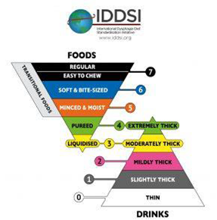
Thickeners

Slide 27
Recording Thickeners
Care plans must contain clear documentation of consistency of food and drinks, and duration of treatment.
MAR charts should list the thickener and consistency prescribed. It is not appropriate to record every administration on the MAR, as MAR design does not usually support this, but it should refer the reader to the fluid intake chart/thickener record used.
Medications
Any drinks (e.g. water) given with oral medication will need to be thickened. Medication in liquid form may also need to be thickened to the correct consistency. Thickeners are not licensed for mixing with medicine so decisions on medication administration should be made on an individual basis and be clearly documented. A pharmacist must be involved in this decision.

Slide 28
Classification of Medicines
The Medicines Act 1968 defines three categories of medicines
  GSL
  P
  POM (including CD POM)
Prescriptions can be written For [GSL] [P] or [POM] medicines.
Notes:
Refer the trainees to the Pre-workshop Booklet
Ask them again what GSL, P and POM stand for
Show the care workers Page 4 in the Pre-Workshop booklet – Introduction to medication training for Domiciliary Care Workers
At this point the trainer needs to mention Controlled Drugs and the fact that once in a patients own home they are treated just like any other drug. This is different from a Care Home setting where there are strict rules on recording and storage.
Tell the care workers:
Controlled Drugs
Care staff collecting controlled drugs (CD’s) prescriptions from the pharmacy/dispensing doctor practice will need to provide personal identification.
Once a Controlled Drug, that has been prescribed for the service user by an authorised Prescriber, is in the service user’s own home the safe storage and recording requirement for controlled drugs does not apply. The drug should be treated the same as all other medication.
Controlled drugs that are no longer required should be returned to a Community Pharmacy for disposal with the service user’s consent.

Slide 29
What does GSL/P/POM mean/where can you obtain these medicines?
General Sales List (GSL)
Pharmacy medicine (P):
Prescription only medicines (POM):
Notes:
GSL (General Sales List) – self selection in shops – e.g. would be small packets of 16 paracetamol
P (Pharmacy Medicines) – available from the pharmacy/chemist – e.g. 32 co-codamol tablets
POM (prescription Only Medicines) – need a prescription – e.g. Blood pressure medicine (such as Lisinopril)
An example of a
GSL - would be small packets of 16 paracetamol
P - 32 co-codamol tablets
POM – Blood pressure medicine e.g. Lisinopril

Slide 30
What does GSL/P/POM mean ?
General Sales List (GSL):
Self selection in shops
Pharmacy medicine:
Available from the “chemist”
Prescription only medicines (POM):
Need a prescription
(Controlled drugs:
Need a prescription but have other restrictions (also
POM) )
Notes:
An example of a
GSL - would be small packets of 16 paracetamol
P - 32 co-codamol tablets
POM – Blood pressure medicine e.g. Lisinopril

Slide 31
Administration
The 7 Rights of Administration:
The right service user receives
The right medicine
At the right dose
Via the right route
At the right time
With the right documentation
And the right to refuse
Notes:
Stress that giving medication in this way is just common sense but the carer should go through this process every time they administer a medication.
Remind the Care workers that there is a quiz at the end of the session.

Slide 32
Administering Medication
Under the Joint ERYC Adult Services and NHS ERY CCG Policy - Administering Medication Safely in the Home Care Sector June 2021.
Care Workers are not allowed to administer medication from a Monitored Dosage System.
  Care Workers can only administer medication from
  Original Boxes and Bottles prepared by the Pharmacy
  Or Dispensing Practice and record the administration on
  A Domiciliary Medication Administration Record.
Notes:
When Care workers administer medication from original boxes and bottles they can easily recognise each medication. This means that if a medication has been refused , spat out dropped, the care worker can document the correct medication easily.
Monitored dosage systems or commonly referred to as MDS, Nomads, Blister Packs usually involve a set of 7 by either 4 or 6 blister holes relating to days of the week and the times of dosage in to which several medication can be put. Therefore they can easily be a number of medications in each hole, should a medication be refuse, spat out or dropped then it may not be easily recognisable by the care worker and hence lead to errors in documentation and confusion for the care worker.
Also not every medication can be placed in a Monitored Dosage system so original packaging would also be used alongside a MDS.
It is important to emphasis that some service users may have a Monitored Dosage system that they use themselves to maintain their independence with medication, should a care worker become concerned about the service users ability to use their MDS then the Care Worker should contact their line manager.

Slide 33
Administering Medication
Read the service user’s Support Plan to check medication needs.
Wash & dry hands and get together any equipment needed to
help with administering the medication, including wearing PPE.
Ask the service user if they are ready to take their medication before it is removed from the container.
Check that service user name is correct on domMAR
Check that service user name is correct on containers.
Ask service user to sit upright.
Administer medication as laid out in the Support Plan.
Record on the domMAR each medication as it is administered
Any concerns should be fed back to your line manager
Notes:
This slide is fairly self explanatory and the information below can be used to discuss this slide with the care workers.
Ask the service user if they are ready to take their medication
Common sense
Provides an opportunity for conversation to the service user who might not see anyone else
Helps to get the service user ready to take their medication and promotes cooperation.
Check that service user name is correct on domMAR
Check that service user name is correct on containers.
These two points even more important if you have a married couple both with medication needs
Wash and dry hands.
Get together any equipment needed to help with medication.
Ask service user to sit upright.
The service user should be in sitting upright or a standing position before help with medication is given. If this is not possible then the carer must report this to their line manager who can ask advice from the service user’s GP, Community Pharmacist
Administer medication as laid out in the Support Plan.
Recorded on the domMAR each medication as it is administered
Any concerns should be fed back to your line manager
Medication quiz question 6 – ensure that these steps are covered as they appear in the quiz at the end

Slide 34
Administering Medication
What happens if a Service User does not want to take their medication?
  If a service user does not want to take their medication even after encouragement then record on the medication record chart as a refusal. Inform your supervisor.
Try and find out why they do not want their medication but under no circumstances should a service user be forced to take their medication.
Medication should not be given covertly
  The only exception to this is following a Best Interest Meeting has been held.
Notes:
Sometimes a person may refuse their medication because they are simply not ready to take their medication and if approached again later in the Care workers visit are then happy to take their medication.
The care workers may have come across this and tell you how they dealt with it.
Consider aspects in previous slides about barriers to taking medicines

Slide 35
The Five principles of the Mental Capacity Act
The Act is underpinned by five principles, which are explained in the Mental Capacity Act code of practice:
  A presumption of capacity
  The right for individuals to be supported to make their own decisions
  That individuals must retain the right to make what might be seen as eccentric or unwise decisions
  Best interests
  Least restrictive intervention
Notes:
The mental capacity act affects what happens with medication, if we look at the five principles
a presumption of capacity - every adult has the right to make his or her own decisions and must be assumed to have capacity to do so unless it is proved otherwise - you must not assume someone lacks capacity because they have a particular medical condition or disability.
the right for individuals to be supported to make their own decisions - a person is not to be treated as unable to make a decision unless all practicable steps to help them do so have been taken without success. Every effort to encourage and support people to make the decision for themselves. If you establish lack of capacity, it is important to involve the person as far as possible in making decisions.
that individuals must retain the right to make what might be seen as eccentric or unwise decisions – what seems eccentric to us may feel very different to the individual – you cannot treat someone as lacking capacity because of this.
best interests – everything you do for or on behalf of a person who lacks mental capacity must be in their best interests
least restrictive intervention - anything done for or on behalf of people without capacity should be an option that would cause less restriction to the person’s basic rights - as long as it is still in their best interests.

Slide 36
Covert administration – Specialised Technique individualised to the person
What is it?
‘Hiding of medication from individuals in food or drink in order that the medication can be given without the person’s knowledge or consent’
When is it needed?
Without medication there is a real risk to health
Problems?
Potential assault, problems with medication e.g. stopping it working or altering release

Slide 37
Covert administration continued
Some patients may lack the understanding as to why the medicines are necessary and lack the ability to give consent (for example dementia patients or Learning Disabilities)
Medication may need to be given in patients best interest and would be as a last resort
If disguising medication in food is required it must be only after a best interest meeting that is correctly documented and involves all parties - relatives, carers and pharmacy.
The support plan should detail the decision, procedure and the need for additional training.
Regular reviews are required
Notes:
Covert administration only where the Service User lacks capacity.
Explain that this is different to just mixing with food to aid swallowing.
May be a different procedure for each medication
Needs to be reviewed regularly
Carer should ensure all in place before administering
If legal framework is not in place then this potentially is deception
Administering medicines in food or drink can alter their therapeutic properties and effects – always take advice from a healthcare professional to make sure medicines are safe and effective – for example, some medicines can become ineffective when mixed with certain foods or drink or if a slow release medication is crushed it may result in overdose or increased adverse effects due to the whole dose being released too quickly. Records must be kept of what was discussed and agreed at the meeting.
Covert administration is only likely to be necessary or appropriate where:
a person actively refuses their medicine
that person is judged not to have the capacity to understand the consequences of their refusal. Such capacity is determined by the Mental Capacity Act 2005
the medicine is deemed essential to the person’s health and wellbeing
All reasonable efforts should be made to give medicines in the normal manner and alternative methods of administration should be considered first, for example, liquid rather than solid dose forms.
A ‘best interest meeting’ would need to take place involving staff, the health professional prescribing the medicines, pharmacist and family member or advocate, to agree whether administering medicines covertly, is in the person's best interests and how and when the medication will be administered covertly.
A regular review of covert administration is required – new medication, medication changes, etc.

Slide 38
What is the name of the Joint ERYC and NHS ERY CCG Policy?
Administering Medication Safely in the Home Care Sector June 2021
What is a domMAR?
What does GSL stand for?
Domiciliary Medication Administration Record
General Sales list
3 Categories
GSL, P, POM
The Medicines Act 1968 defines how many categories of medicines?
Medicines prescribed for a person are that persons ....?.......
Monitored Dosage System
Medicines prescribed for a person are that persons property
Domiciliary Care Workers cannot administer medication from a ?
Medication Administration needs will be written in the Support Plan
How does a Care Worker know a Service User has Medication Administration needs
Who obtains and records the Service User’s consent to administer medication?
The Adult Services Community Wellbeing Team (formerly Care Management Team)
Any one can administer prescription medication so long as it is in accordance with the directions of the Prescriber
Where do you record medication administration?
Who can administer prescription medication to a person?
domMAR
Pharmacy
Report concerns about medication to your Supervisor
What does P stand for?
What should a Care Worker Do if they have a concern about Medication?
When the administration of medication is part of the Support Plan can family member still help with medication?
Yes. The help family members give should be outlined in the Support Plan
What does POM stand for?
Prescription Only Medication
Notes:
Re-cap
Tell the Care Workers that All the answers to this slide can be found in the Introduction to Medication Training for Domiciliary Care Workers that should have been completed prior to attending this session
Randomly choose questions from the screen and when the care workers have had chance to answer click on the question box to show the answer to the question.
When all the questions have been answered move the pointer to the blue forward button at the bottom right of the screen to take you back to the next slide of the Domiciliary Medication Training Presentation.

Slide 39
Administering Medication
Post-workshop Booklet
Notes:
BREAK?
Go over aspects of administering different types of medication. Especially consider different formulations of ‘tablets’ –
Soluble/dispersible
Chewable/suck
Buccal
Sub-lingual
Oro-dispersible
Think about drops –
Oral drops eg Vitamin D
Eye drops
Ear drops
Nasal drops
Some drops can be used in eyes/ears/nose so check where to apply . An example is Betnesol Drops a steroid .

Slide 40
Inhalers
Carers should not normally assist with reliever inhalers as these are usually ‘when required‘ doses and the service user needs to be able to use these outside of care calls
If any problems are identified where the service user cannot use this type of inhaler then the line manager should be notified
Notes:
The carer should ensure that the Service User can reach these relievers e.g. they are on a table close to where the Service User sits/on the bedside cabinet

Slide 41

Inhalers
If the service user can operate their inhaler then the carer may be asked to prompt or prepare the inhaler and pass to the service user - this would be recorded in the daily diary and detailed in the support plan
If the service user is unable to operate their preventative inhalers and there is no alternative device the carer may be asked to administer the inhaler
The inhaler would need to be a monitored dose inhaler (MDI) and used with a spacer device see picture above of some MDIs
Follow the process in Appendix 7 of the policy
This would only normally be those inhalers known as preventers with regular doses
Notes:
Any concerns it is important to refer to line manager
Discuss the process in Appendix 7 in the policy

Slide 42
Inhalers
In an emergency situation where the Service User is suffering breathing difficulty the carer should call 999 and follow any directions
Inform Line Manager/DCA
This activity should be recorded on the domMAR/diary notes as soon as possible
Notes:
After going through the various administration techniques then show them the Competency section in the Medication Training for Domiciliary Care Workers Post Workshop information Booklet on Page 15. Talk briefly on the fact that their line managers will use this section to record competencies.
Then ask Trainees to turn to page 18 in the Post training Workbook
All training should be recorded here.
Emphasis the importance of keeping the booklets safe - this is their record of their competency.

Slide 43
When required medication (prn)
Prescriber to give reason medication needed e.g. pain relief, anxiety
Must always state maximum dose in 24 hours
Prescriber should avoid giving a choice of dose (e.g. 1 or 2), if possible
The use of PRN as a direction should only be used when there is no alternative
Notes:
See 4.6.5 of policy for detail
If asked, prn or PRN stands for “pro re nata” (as the circumstance arises) – in medicine it is commonly used to mean “when required”.

Slide 44
When required medication
Support plan to give detail
Record on domMAR when not required as ‘N’
If a choice of dose is given (e.g. 1 or 2 tablets or 5ml or 10ml) then the carer would need to indicate the dose administered on the domMAR.

Slide 45
Warfarin - Appendix 4
What is warfarin? It is a blood thinner (anticoagulant) and is used for different reasons:
DVT – deep venous thrombosis, e.g. in the leg, can also be used to prevent e.g. if been in bed after operation, such as knee/hip surgery - this would be short term.
AF –Atrial Fibrillation – heart problem - lifelong.
PE – pulmonary embolism - first time short term but if it occurs again long term.

Slide 46
Warfarin continued
  Whilst a person is on warfarin they must have a regular blood test called an INR test. The results of the blood test will determine if the dose needs to be increased, decreased or to stay the same
  All dose changes for warfarin should be confirmed in writing by the prescriber. It is safe practice to attach the written confirmation of the dosage, supplied by the anticoagulant clinic or GP, to the domMAR chart.
  The details of the next INR test will also appear on this document which should be fed back to the duty manager a note should be added to the domMAR chart to warn the carer to look for another dose change

Slide 47
Warfarin continued
Extra care is needed if asked to administer warfarin as it is potentially harmful if not taken correctly.
GPs have been asked to change warfarin to an alternative anticoagulant where possible to prevent errors. This new medication has a regular dosing pattern e.g. one daily.
If you come across a service user on Warfarin, check to see if an alternative medication has been explored.
There may still be some service users where warfarin is the only option.
Notes:
Show the NPSA alert and the Yellow Book. The higher the number INR the more likely wont clot . Therefore needs to be kept in range .
GP must check that INR has been done before issuing prescriptions, pharmacist may also be checking as well
Additional blood tests may be necessary if a resident is prescribed medicines which interact with warfarin e.g. something new started or something stopped as this can affect clotting .
Each organisation should have a procedure in dealing with warfarin. Discuss yours:
How do you receive change of dose from GP?
Does anyone know what strengths there are and what is special about this medication? – all manufacturers use same colour for each strength as a safety net.

Slide 48
Warfarin
  A verbal message to change the dose should only be accepted in an emergency, always ask for written confirmation as soon as possible
  GP should prescribe only 1mg tablets to reduce error
  This is the only medication where ‘as directed’ is allowed as the dose may change

Slide 49
Question?
If you have any concerns about the administration of medication to a service user what should you do???
  Any concerns should be fed back to your line manager
  Make a note in the diary sheets and on the domMAR what your concern was and what answer your line manager
Notes:
Use this slide to emphasis the point that concerns should be forwarded to the line manager. This slide can be used to speed up or slow down the presentation depending on time pressures.

Slide 50
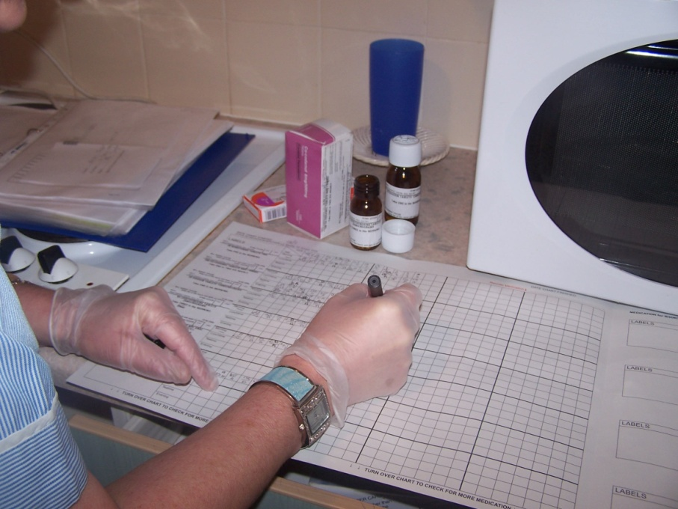
Recording the Administration of Medication
Care Workers must keep a record of the administration of medication to Service Users.
Domiciliary Medication Administration Record (domMAR)
Notes:
Explain the domMAR before starting the domMAR exercise

Slide 51
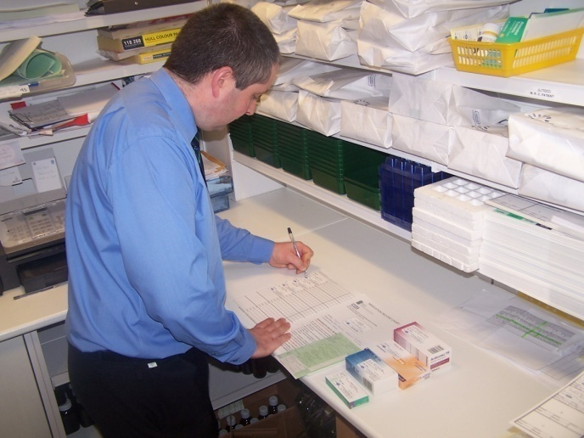
How does a Service user get a domMAR
The Community Wellbeing Team use the Fullers Assessment tool during the Service users assessment of need and if medication administration is required they complete the domMAR request form and send it to the service users normal pharmacy.
Community Pharmacies, Dispensing Practices and Hospitals can only provide the domMAR once they have received the domMAR request form.

Slide 52
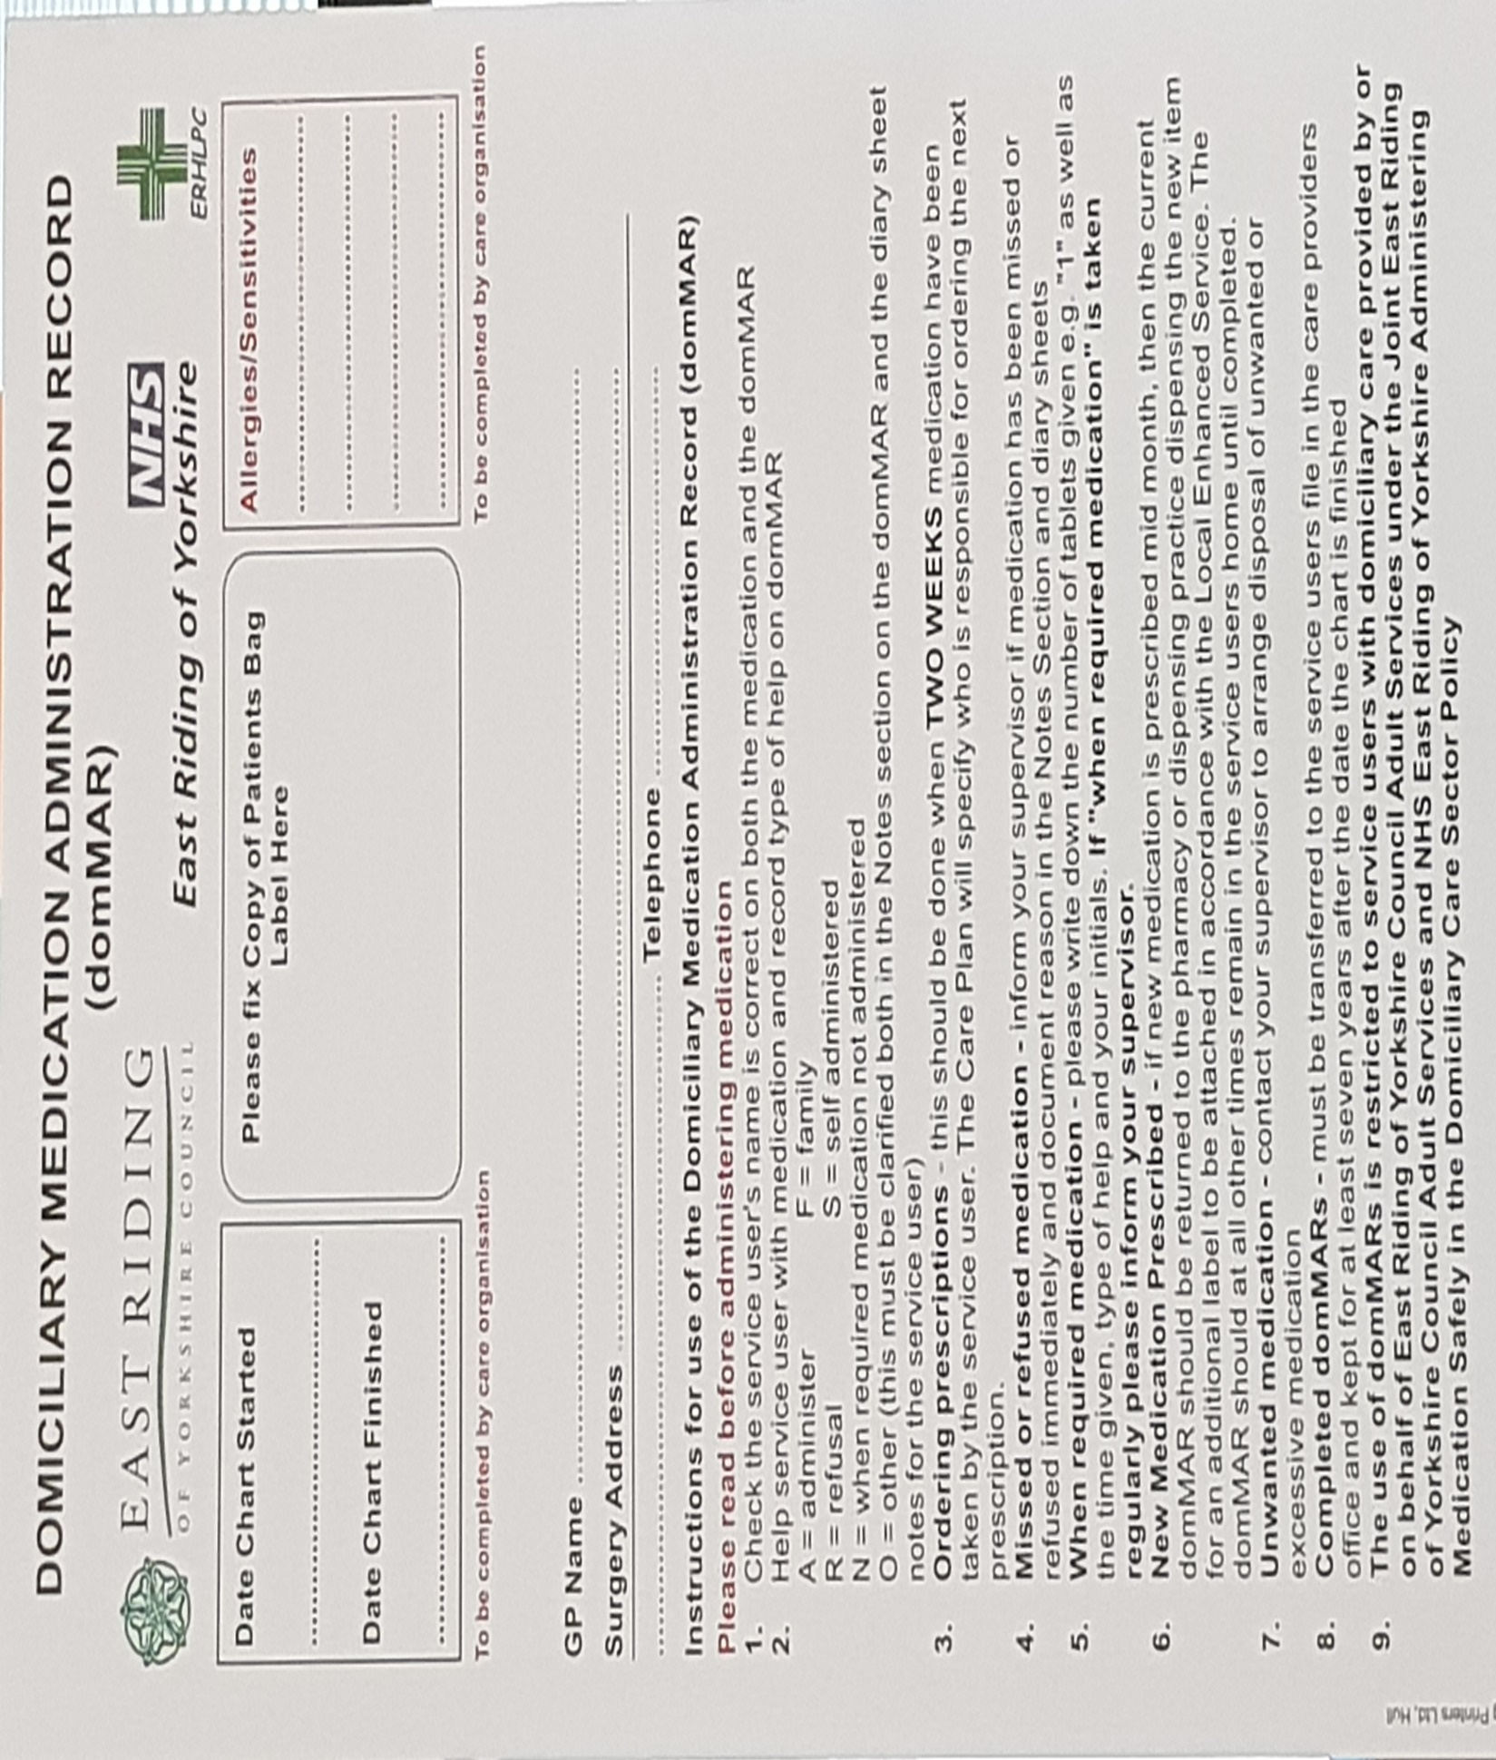
Notes:
This is the latest Domiciliary Medication Administration Record (domMAR). You will see that a box has been added to the top right hand side of the domMAR where you can record service user allergies/sensitivities. The Pharmacy will not have this information unless you make them aware of this so as a service provider you may need to add it to the DomMAR yourself.
TWO additional codes have been added to the domMAR:
F for when family administer medication for the individual, although we can only request that they complete this.
S for service users who are self-administering medications/creams

Slide 53
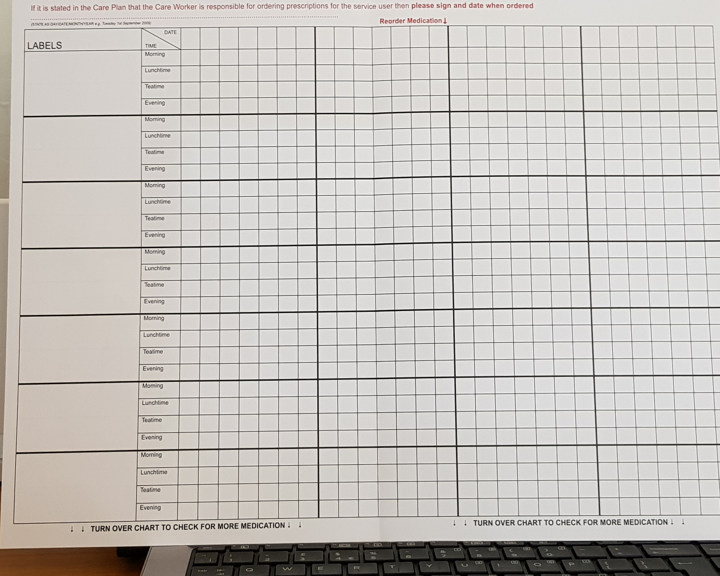
Notes:
Another change is that the date for ordering medication has been brought forward to allow the Pharmacy more time to dispense medication.

Slide 54
How do Community Pharmacies, Dispensing Practices or Hospitals prepare domMARS?
domMARs are prepared via an NHS Enhanced Service – under Standard Operating procedures
Duplicate prescription labels are applied to the domMAR at the time of dispensing the prescription and made them tamper evident
Community Pharmacies, Dispensing Practices and Hospitals can not give out copy labels
Notes:
These next two slides inform the Care Workers on the role of the Pharmacy/Dispensary
It is important here to emphasis that community pharmacies cannot give out spare labels for a third party to attach at a later time to a domMAR

Slide 55
domMARs
All medications administered by the carer should appear on the domMAR.
External/Cream only domMARs may be used if the carer is only administering e.g. creams or patches.
Care Workers record the administration of the medications the Support Plan states. It is important that the carer only administers those medications listed in the support plan (unless short term medications e.g. anti-biotics).
Once fully completed a domMAR should be returned to the Care Providers office for safe storage for eight years.
The Care Provider should monitor and review the service provided via monthly audits of domMAR charts
Notes:
Emphasis that once a domMAR is fully completed it should be returned to the Care Providers office for safe storage. (This forms part of the Medication Quiz)
Filling in the domMAR
Split into groups and use the domMARs to show how the administration of medication is documented
Give the groups some scenarios including refusal, missed dose, etc.
There is approximately 15minutes for this exercise

Slide 56
Mid-month medications
If a prescription is given mid month then the domMAR should be taken to the Pharmacy/ Dispensing Practice with the prescription to obtain the medication and update the domMAR.
If this is not possible the pharmacy may provide a second domMAR and it should be labelled 2 of 2 to indicate this is a second chart.
If this is not possible then the carer may be directed to handwrite the medication onto the chart following a safe procedure.
Notes:
Remind the care workers that if a service user has a prescription mid month then the domMAR will need to be returned to the Pharmacy/Dispensing Practice for updating.

Slide 57
Handwriting charts - Appendix 3 of the policy
May be necessary due to:
New mid-month medication where there is no other option
Change in dose following hospital discharge
Notes:
if it is necessary for care workers to do this you would be directed to do so by the duty officer.

Slide 58
Handwriting charts - process
Confirm the need with duty manager
Duty manager to direct only trained carers to handwrite the chart
Copy exactly the medication labelled by the pharmacy including any warnings e.g. take after food
Use 2 spaces if needed
Write in black ink and initial domMAR
Next carer going in to check entry and initial
Notes:
Appendix 3 of the policy
Some organisation allow their carers to send photograph of entry to be signed off in the office
Complete a domMAR handwriting exercise 10 minutes . You can use any MAR chart to do this . Each carer to pass their completed handwritten MAR chart to the person next door . Is it legible? Ensure all warnings are copied as this is often an error.

Slide 59
Electronic Medication Administration Records (eMARs)
Currently there are 2 systems in operation:
The community Pharmacist enters the service user’s medication onto the eMAR via a portal. (This is the preferred system).
The DCA staff enter the service user’s medication onto their own system. Only trained and competent staff must do this and a 6 monthly audit must be undertaken.

Slide 60
Ordering medication on behalf of service users
To minimise additional calls for the DCA medication should be ordered by electronic means using the:
Practice GP on-line service.
NHS App.
NHS-mail directly to the practice.

Slide 61
Ordering medication on behalf of service users (continued)
This constitutes third-party or “proxy” access. The service user and GP will need to consent to access.
The DCA should liaise with the GP to agree the most appropriate method for each service user.

Slide 62
Non – prescribed medications
If service user asks for support with non-prescribed medication refer to duty manager who will give guidance as to your agencies procedures for this
Any procedures need to include contact with GP or Pharmacist to ensure non-prescribed medications are safe to be taken with the individual’s prescribed medication.
Robust procedures & guidance must be in place in your organisation for staff to follow and this must be audited regularly.
Notes:
Don’t let carers get too hung up about this slide.
It is rarely used as far as we know but is an important part of the service if required.
If support is requested eg it may be a service user has always taken a cod liver oil tablet and wants to continue. Once risk assessed with prescribed medication then carer will need to handwrite onto the domMAR .
Important to administer only from original ,in date ,container as this will have dose etc .

Slide 63
Wastage of ‘as required meds’
Actions to take by Care Staff
Notes:
26/6/15: Have been advised by medicines management team to highlight to staff if you note that e.g. Only 10 paracetamols have been used in a month and the repeat prescription is for 100 each month. When the carer returns the unused tablets to the pharmacy they need to highlight this with the pharmacist. Medicines Management will also be in contact with the GP for them to reduce the quantity on the prescription. Also creams, which if these are not being used and the size of the container and amount being returned.

Slide 64
Disposal
If there is an excess of medication in a Service Users home contact your line manager to arrange disposal
Carers should only dispose of medication if there is no other option
The service user/family should make arrangements for disposal at the pharmacy where possible
Medicines are a service user’s property and verbal consent should be obtained prior to disposal
Consent should be recorded
Medicines to be disposed of should be listed in the Diary notes and taken to the nearest local Community Pharmacy
Notes:
Run through this slide with Care Workers.
Read from the Joint ERYC and NHS ERY Policy – Administering Medication Safely in the Domiciliary Care Sector
4.3 Disposal
Dropped Tablet
Discuss the example of dropping a tablet on the floor prior to administering it to the Service user. What would be the process?
The steps we want them to come up with are:
Place in a disposable bag/envelope to take back to the Pharmacy at the end of the month
Note in the Support plan and domMAR what has happened
Administer a clean tablet in accordance with the domMAR
Alert Line Manager as this may mean that there is a shortage of medication to complete the 28 day period
The policy does not allow flushing down the toilet
.

Slide 65
Disposal
  Dropped tablets should be avoided by good administration technique
  If an Individual medication (e.g. single tablet) has been dropped on the floor or spat out it should be placed in a small sealed plastic bag and fully labelled ‘for destruction’ and stored safely until the end of the month
  Make note in diary/domMAR
  Inform duty manager as they may need to obtain more supplies to prevent running out
  Make arrangements for return at the end of the month
Notes:
Use good technique to reduce dropping on floor

Slide 66
Returning medication to a Community Pharmacy
Community Pharmacies (CP) accept returned medication back as part of their NHS contract. It is important that this continues for patient safety.
If pharmacy bins are full they may need to temporarily suspend the service until these are collected.
If possible and it is safe to do so waste medication should be stored in the service user’s home until the CP can accept medication again.
This medication should be stored in a sealed bag and labelled as such and stored out of sight of any children and vulnerable people.
Notes:
The Community Pharmacy contract is held with NHSE and it is NHSE that is responsible for the collection of waste medication from the CP
If a CP is not accepting waste medication another may be, so if there is any risk to the SU or their family it may be necessary to phone round to find another CP who can accept the returns before venturing out with them.
Every Community Pharmacy should accept returns from any Community Pharmacy – this is part of the Community Pharmacy contract with NHSE.

Slide 67
Returning medication to a Community Pharmacy
Collection by the CP is not in the NHS contract.
If a return by the carer is necessary, the Provider should liaise with the CP to ensure that they are accepting returns.
If the SU wishes, labels should be removed before returning to the CP but there is no legal requirement to do so, however, it may be more appropriate to just return the strips of tablets to the CP and destroy the medication boxes in the service user’s home.
It is advisable to return Controlled Drugs in a separate bag if these are easily identifiable, e.g. following the death of a spouse and, as usual, should contain no sharps.
Notes:
Please note if the service user wishes their labels to be removed from the medication then this should be done before going to the Pharmacy.
If it is known that returned medication contains Controlled Drugs then please separate if possible from other medication so that they are easily identifiable for the Pharmacy.

Slide 68
Controlled Drugs Schedules
  Schedule 1 - includes the hallucinogenic drugs e.g. LSD, the ecstacy-type compounds
  Schedule 2 - main group e.g. morphine (MST, /Zomorph) diamorphine
  fentanyl (durogesic/Matrifen/Fentalis/Mezolar),
  oxycodone (Shortec/Longtec/Oxycontin/Oxynorm),
  methadone
  Schedule 3 - includes temazepam, buprenorphine, tramadol, midazolam, pregabalin and gabapentin
  Schedule 4 - includes lorazepam, nitrazepam, diazepam
  Schedule 5 - includes medicines which contain controlled drugs in very small amounts
Notes:
A copy of the Controlled Drugs Schedules has been added just to make carers aware of some of the key controlled drugs. Although, once they are in a service user’s own home they should be treated the same as any other medication.
This is for information and carers are not required to know these

Slide 69
Storage
Medication should be kept in a safe place away from children
Below 25 ^{o C} although some medications need to be stored in a fridge. If fridge storage is necessary it will state on the label
If secure storage is required this should be stated in the support plan
Notes:
Currently, due to Covid 19, some Pharmacy’s are refusing to accept medicines returned to them, due to lack of storage space.
A box of medication will always have the storage temperature on it, either 2-8 degrees C or Below 25 degrees C
2-8 degrees C would need to be stored in a fridge.

Slide 70
Duty of candour
  Regulation 20 of the Regulated Activities Regulations 2014
  If things go wrong the DCA must
  Be open and transparent about the error
  Support the person
  Apologise for the error, preferably in writing
  Make a log of the error
Notes:
Duty of Candour is Regulation 20 of the Regulated Activities Regulations 2014. It covers any event which adversely affects the well-being or safety of a service user.
The service provider must be open and transparent with individuals about their care and treatment and should something go wrong they must tell the individual what has happened, provide support and apologise.

Slide 71
Medication Errors
A medication error is defined as a mistake made in the prescribing, dispensing, ordering, delivery, storage or administration of medication that leads to a service user receiving the wrong medication, unintentionally missing a dose or being at risk of harm.
If you think an error has occurred with medication what do you do?
Report it immediately to your line manager
Notes:
Care workers should report medication errors to their line managers straight away.
From 1 October 2010, all adult social care services including DCAs must notify the Care Quality Commission (CQC) under the Health and Social Care Act 2008 about specific incidents and errors. The notification must be made in writing and the CQC provide template forms to simplify the notification process, which should be emailed to CQC notifications.
Errors and untoward incidents
For the purpose of this Policy, a medication error is defined as a mistake made in the prescribing, dispensing, ordering, delivery, storage or administration of medication that leads to a service user receiving the wrong medication, unintentionally missing a dose or being at risk of harm.
If a medication error occurs it should be reported immediately to an appropriate manager, the advice of a GP or pharmacist should be sought immediately and an accident/incident form completed. The DCA must apply the harm table to determine whether a safeguarding concern needs to be raised and where this has serious consequences for a service user you must make a Safeguarding alert. This may also result in appropriate further training and competence testing. It is important that all errors are recorded and the cause investigated to learn from the incidents and prevent a similar error happening in future.
DCWs should be trained in recognising medication errors, incidents and near misses and be clear as to the definition of a medication error, incident and “near miss”

Slide 72
Medication errors
If a worker is aware of having made an error in administering medication or notices that an error has been made e.g. by another worker, the pharmacy or the prescriber:
Notify the duty manager - if unable to contact the manager do not delay in seeking medical advice from the service user’s GP/ appropriate healthcare professional (e.g. pharmacist or A&E).
Medication errors must not be treated as trivial and ALL must be reported.
Enter details of the error on the domMAR chart or in the daily diary
Notes:
Some errors may appear trivial e.g. omitting a dose of paracetamol or antibiotics however since it is not appropriate for the DCW to gauge the seriousness of an error advice from a professional MUST be sought.
If a service user is unwell as a result of the medication error or incident, medical assistance should be sought straight away. If serious negligence or an attempt to cover up an error is discovered, this should be treated as a disciplinary offence and the safeguards alert process should be followed, including informing the Police. This may result in legal action against the DCW, their employer or both.
All notifiable incidents should be reported to the CQC. However, DCAs should not ignore other errors, incidents or near misses - no errors should be ignored.

Slide 73

Any
Questions?

Slide 74
Quiz
A copy of the Quiz that you now need to complete, as part of this medication course, is available on the ASC LeadER website.
Please download and save a copy of the quiz and then complete the quiz and return it within the next 2 weeks to the following email address:
lyn.graham@eastriding.gov.uk
Notes:
Ask the learners if they have any questions before the quiz.
Ask the learners to spread out so that they can work on their own and if they don’t understand anything to put their hand up and you will come to them individually.
Remind learners that a score of at least 75% or 30 out of 40 will be needed to pass the session, all the answers to the quiz have appeared through out the session and learners are also allowed their pre and post workshop booklets with them whilst taking the test.
Give out the question sheet – remind them to write their name on it.
At the end of the 20minutes, ask the trainees to swap with the person next to them. Tell the trainees that if the person has incorrectly answered a question to write the correct answer along side.
Once corrected collect the answer sheets in to verify mark and note any care worker scoring under 30.
Ask the trainees for questions and hand out evaluation forms
Remind Trainees it is their responsibility to keep the workbooks safe as they are evidence of training.
Hand Out Certificates of attendance.
Follow up to training
If any trainee has not achieved the pass mark reassure them and organise with their line manager an action plan including an opportunity to re-sit quiz.

